Slide 1

PROJECT ON INTRODUCTION TO DATA MANAGEMENT
HEART FAILURE PREDICTION
End-term presentation of INT217
PRESENTED BY : AKSHAY GUPTA
REGISTRATION NO :11913896
B.Tech IT (INFORMATION TECHNOLOGY)

Slide 2
WHAT IS DATA MANAGEMENT
Data management is the process of ingesting, storing, organizing and maintaining the data created and collected by an organization.
The data management process includes a combination of different functions that collectively aim to make sure that the data in corporate systems is accurate, available and accessible.

Slide 3
IMPORTANCE OF DATA MANAGEMENT
Data increasingly is seen as a corporate asset that can be used to make more-informed business decisions, improve marketing campaigns, optimize business operations and reduce costs, all with the goal of increasing revenue and profits. But a lack of proper data management can saddle organizations with incompatible data silos, inconsistent data sets and data quality problems that limit their ability to run business intelligence.

Slide 4
Microsoft Excel
Microsoft Excel is a spreadsheet program used to record and analyze numerical and statistical data. Microsoft Excel provides multiple features to perform various operations like calculations, pivot tables, graph tools, macro programming, etc. It is compatible with multiple OS like Windows, macOS, Android and iOS.

Slide 5
PIVOT TABLE
A PivotTable is a powerful tool to calculate, summarize, and analyze data that lets you see comparisons, patterns, and trends in your data.
Create a PivotTable in Excel
1.Select the cells you want to create a PivotTable from.
Note: Your data shouldn't have any empty rows or columns. It must have only a single-row heading.
2.Select Insert > PivotTable.

Slide 6
3.Under Choose the data that you want to analyze, select Select a table or range.
4.In Table/Range, verify the cell range.
5.Under Choose where you want the PivotTable report to be placed, select New worksheet to place the PivotTable in a new worksheet or Existing worksheet and then select the location you want the PivotTable to appear.
6.Select OK.

Slide 7
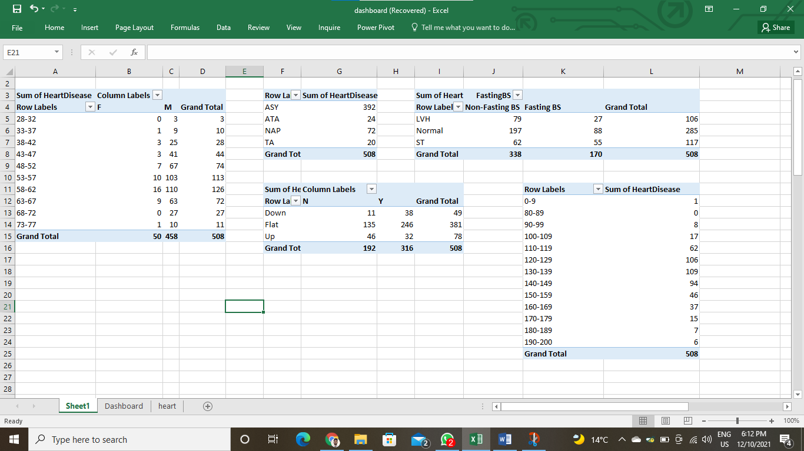
TABLES

Slide 8
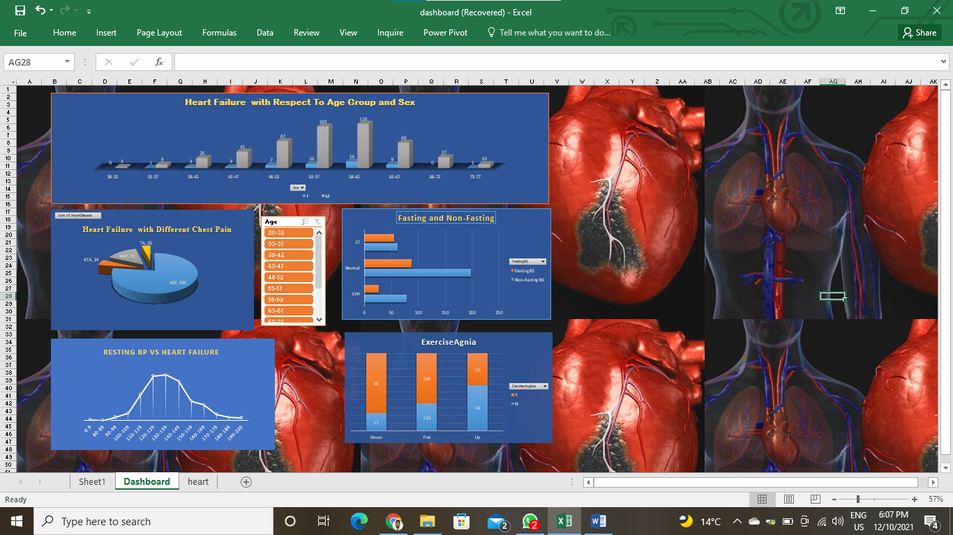
DASHBOARD

Slide 9
Source of Data
All the dataset is taken from a website named as Kaggle.
Link of website is:-https://www.kaggle.com/fedesoriano/heart-failure-prediction

Slide 10
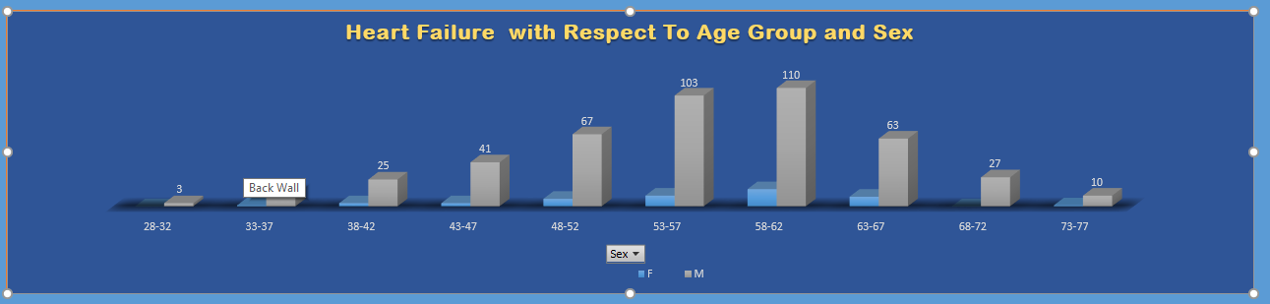
OBJECTIVE 1
This chart shows the prediction of heart failure with respect to age group between male and female.As per the chart after analysis it is concluded that the male age group between 53-62 are more prone to heart failure where as very few female of age group 53-62 suffer health failure rest femake hardly suffers.In all age group male are more prone to heart failure

Slide 11
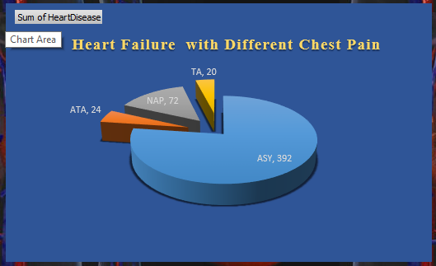
OBJECTIVE 2
This 3-D pie chart depicts the possibility of heart failure in people with respect to different chest types.Basically,there are 4 different types of chest pain,they are TA:Typical Angina, ATA: Atypical Angina, NAP: Non-Anginal , ASY: Asymptomatic. After analysis,it is found that asymptomatic chest are offenly common in people.

Slide 12
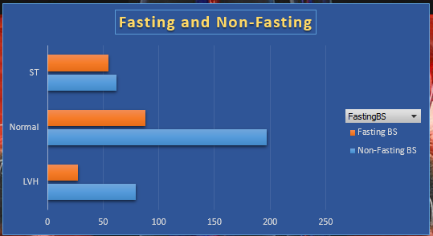
OBJECTIVE 3
This bar chart shows the prediction of heart failure in terms of fasting and restingECG.It seems that people having high blood pressure with normal restingECG are more prone to heartattack.

Slide 13
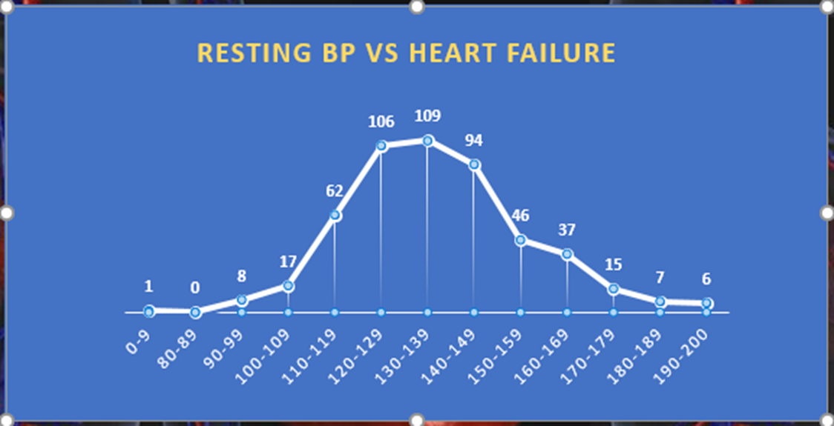
OBJECTIVE 4
This chart shows that the people having resting blood pressure high are more prone to heart failure.

Slide 14
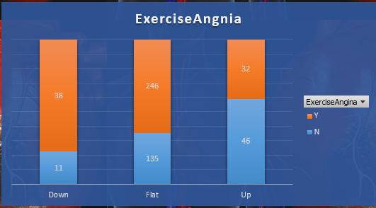
OBJECTIVE 5
This column chart shows that the people who have down and flat ST curve with exercise induced angina are more prone to heart failure than the people having UP ST slope with exercise induced angina.

Slide 15


